Slide 1




Fedora 38
Fedora is a widely used Linux distribution that is available under an open source license. Fedora is an open-source operating system (OS) that is developed on a six- to eight-month release cycle with security and general-purpose functionality as its primary goals. Red Hat provides financial backing for both the operating system and the Fedora Project.

Slide 2


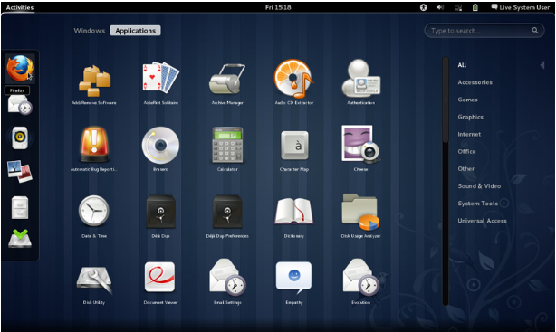
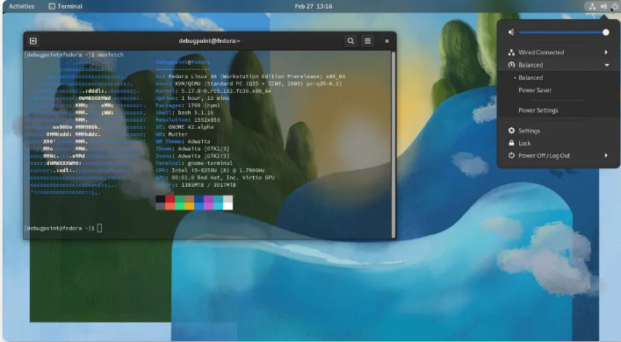
Features
Fedora's features include XML submission and storage, parameterized disseminators, access control and authentication, default disseminator, searching, OAI Metadata Harvesting, and a Batch Utility for mass creation and loading of data objects.

Slide 3
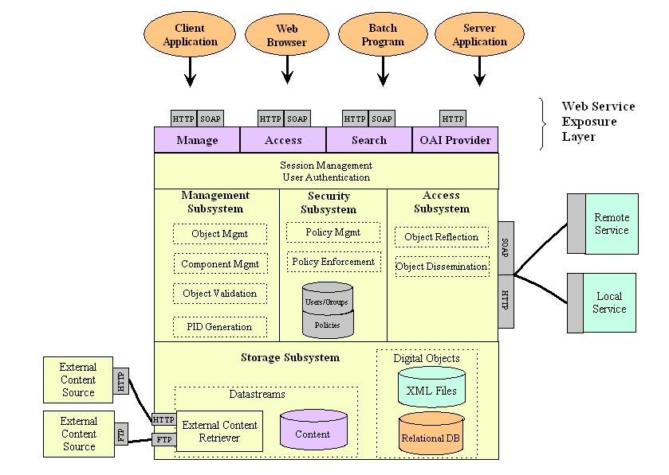
Fedora Repository System
The Fedora architecture provides a powerful and adaptable object model. A few of Fedora's first-phase features are XML submission and storage, parameterized disseminators, access control and authentication, a default disseminator, searching, OAI Metadata Harvesting, and a Batch Utility for bulk creation and loading of data items.

